Slide 1
CS2303: Systems Programming Concepts
Class 15
C++ I/O
Operator Overloading
Friends
Thanks for Prof. Lauer for an earlier version of these slides.
Copyright 2005-2017, Michael J. Ciaraldi

Slide 2
Reading Assignment — Strings
Chapter 9 of Absolute C++

Slide 3
Two kinds of strings in C++
C-String
Not part of Standard Template Library
Array of char terminated by null char '\0'
Like strings in C
String class
Part of Standard Template Library (STL)
Container for supporting w_char, other character sets
Powerful tools for manipulating strings in “natural” way
Meaningful operators

Slide 4
C-Strings
#include <cstring>
Let
char u[] = "This is another string!";
Then
u[0] == 'T' u[1] == 'h' u[2] == 'i' … u[21] == 'g' u[22] == '!' u[23] == '\0'

Slide 5
C-Strings (continued)
Usual string functions
strcpy()
strlen()
strcmp()
strcat()
…
Command line args
argv is array of c-strings
argv[argc] is null pointer
C++ input-output
cout << "Wow!" << endl;
char *c = "This is a string."; char d[25];
… cout << c << endl;
cin >> d;
But watch out for size of array
d = c; //assigns pointers, not characters

Slide 6
C-Strings (continued)
getline(char *s, int length)
Member function of cin
Reads input up to new-line character
Limited by length argument
Also
cin.get()
cout.put()
…
Many other character utilities
#include <cstring>
...
char a[80];
cin.getline(a, 80);
cout << a << "End of Input" << endl;

Slide 7
C-String Summary
Familiar strings from C
Same capabilities as strings in C
Same hazards
Same awkwardness

Slide 8
Standard class string
Part of Standard Template Library (STL)
#include <string>
Included in namespace std
String variables and expressions
Treated much like simple types

Slide 9
Standard class string
Allocates memory long enough to hold both s1 and s2.
Assign, compare, etc
string s1, s3, s3, s4;
s3 = s1 + s2; // concatenation, assignment
if (s1 <= s2) ... // comparison
s4 = "Hello Mom!" // automatic conversion from C-string

Slide 10
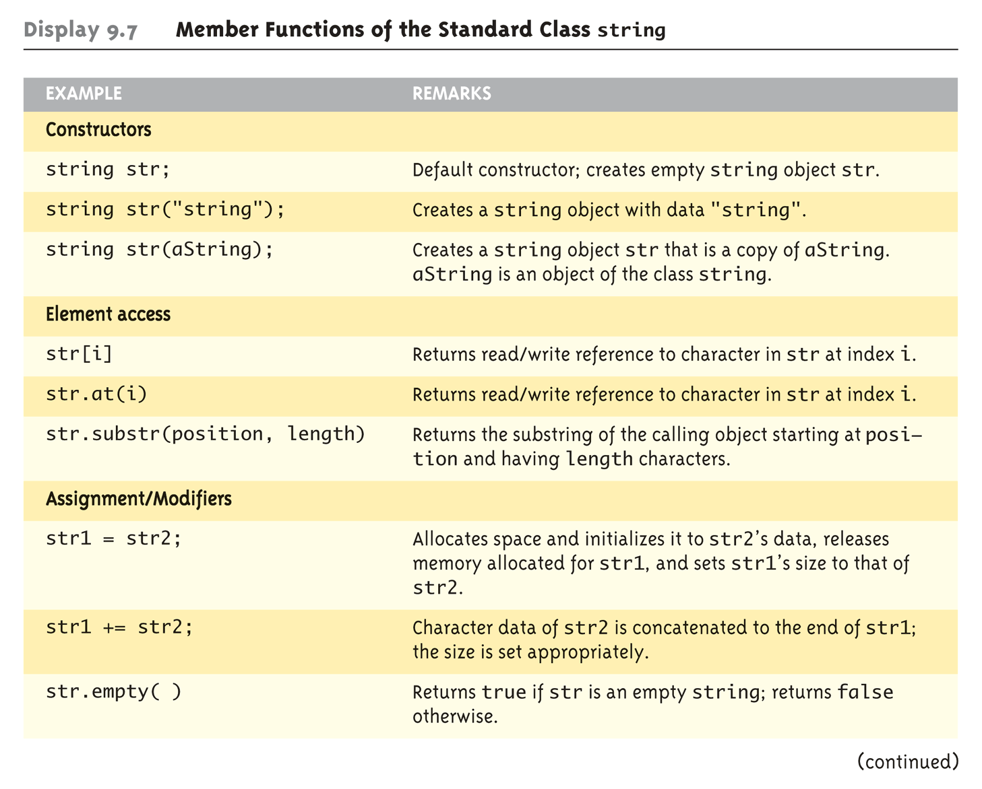

Slide 11
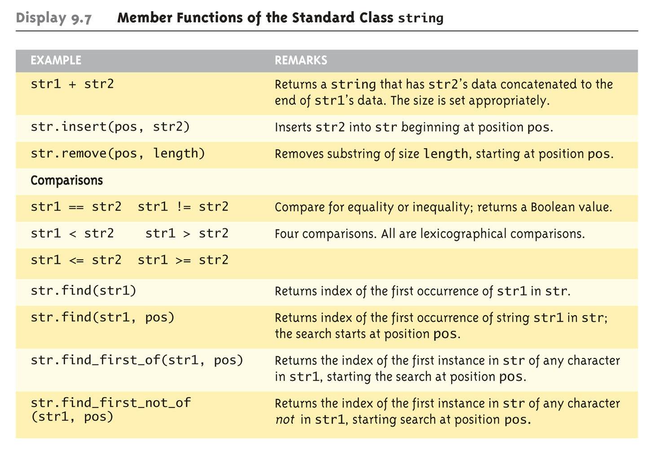
Chapter 9 of Absolute C++

Slide 12
Streams
Reading Assignment:– Absolute C++, Ch. 12
Flow of characters
Input stream
Flow into program
From any source
Keyboard, file, pipe, etc.
Output stream
Flow from program
To any destination
Screen, file, pipe, etc.

Slide 13
Stream Usage
Familiar streams
cin — Input stream object connected to standard input
cout — Output stream object connected to standard output
Other streams
To or from files
Usage similar to cin, cout

Slide 14
Stream Usage (continued)
Class
ifstream
ofstream
#include <iostream> #include <fstream>
Part of std namespace
using std::ifstream; using std::ofstream;

Slide 15
Declaring Streams
Like any other class variable:–
ifstream inStream;
ofstream outStream;
Opening files
inStream.open("myInput.txt");
outStream.open("myOutput.txt");
Absolute or relative pathname of file
cin is an object of class ifstream
cout is an object of class ofstream

Slide 16
Declaring Streams
Like any other class variable:–
ifstream inStream;
ofstream outStream;
Opening files
inStream.open("myInput.txt");
outStream.open("myOutput.txt");
Absolute or relative pathname of file
Optional argument specifying append to file (if it exists)

Slide 17
Input
#include <ifstream>
ifstream fileIn("myFile.txt");
string word;
fileIn >> word; // skips leading whitespace
// stops at next whitespace

Slide 18
Stream Manipulators
setfill(), setw()
Sets fill character and field width of stream
Examples
cout << setfill('0') << setw(2) << hour << ":" << setw(2) << minute << ":" << setw(2) << second << endl;
cout.setw(2); // sets all field widths

Slide 19
More Stream Manipulators
setprecision()
Sets precisions (in decimal places) of floating point numbers
eof()
Returns a bool indicating whether the end of the stream has been reached
True only after program attempts to read past last character of the stream
Usage:– cin.eof()

Slide 20
Other Useful Stream Functions
getline()
Reads stream to next newline, returns string
get()
Reads one character from input stream, returns int
put()
Writes one character to output stream
A long list of manipulators at
http://www.cplusplus.com/reference/iostream/
Absolute C++, §12.2
Stroustrup, §21.4.6

Slide 21
Operator Overloading

Slide 22
Examples of Operator Overloading
string class
+ // concatenation
<, >, <=, >=, == // comparison
=, += // (true) assignment
stream class
<< // stream insertion
>> // stream extraction
Note:– operator= must be a non-static member function. Stroustrup 11.2.2, because the first operand must be an l-value

Slide 23
Why Operator Overloading?
Readable code
Extension of language to include user-defined types
I.e., classes
Make operators sensitive to context
Generalization of function overloading

Slide 24
Simple Example
Class definition:–
Would like to write:–
class complex { double real, imag;
public: complex(double r, double i): real(r), imag(i) {}
}
complex a = complex(1, 3.0); complex b = complex(1.2, 2); complex c = b;
a = b + c; b = b + c*a; c = a*b + complex(1, 2); d = a / b;
I.e., ordinary arithmetic expressions for this user- defined class.

Slide 25
Operator Overloading
class complex { double real, imag;
public: complex(double r, double i) : real(r), imag(i) {}
complex operator +(complex a, complex b); complex operator *(complex a, complex b); complex& operator =(complex a, complex b); ...
}

Slide 26
General Format
returnType operator◊(parameters);
↑ ↑ ↑
any_type keyword operator_symbol
Return type may be whatever the operator returns
Including a reference to the object of the operand
Operator symbol may be any overloadable operator — i.e., all except
:: (scope resolution), . (member selection), .*(selection through pointer to member), ?: (conditional expression)

Slide 27
Reading assignment
Absolute C++, Chapter 4

Slide 28
Operators that Can and Cannot be Overloaded
Deitel & Deitel, Figure 22.1
Deitel & Deitel, Figure 22.2

Slide 29
C++ Philosophy
All operators have context
Even the simple “built-in” operators of basic types
E.g., '+', '-', '*', '/' for numerical types
Compiler generates different code depending upon type of operands
Operator overloading is a generalization of this feature to non-built-in types
E.g., '<<', '>>' for bit-shift operations and also for stream operations
No counterpart in Java!

Slide 30
C++ Philosophy (continued)
Operators retain their precedence and associativity, even when overloaded
Operators retain their number of operands
A.k.a. arity
Cannot define new operators
Only (a subset of) the built-in C++ operators can be overloaded
Cannot redefine operators on built-in types

Slide 31
Outline
Fundamentals of Operator Overloading
Restrictions on Operator Overloading
Operator Functions as Class Members vs. Global Functions
Overloading Stream Insertion and Stream Extraction Operators

Slide 32
Operator Overload Function
Either
a non-static member function definition
or
a global function definition
Usually a friend of the class
Function “name” is keyword operator followed by the symbol for the operation being overloaded
E.g., operator+, operator=, operator->, operator()

Slide 33
Operator Overload Function (continued)
Operator overload function is a function just like any other
Can be called like any other – e.g.,
a.operator+(b)
C++ provides the following short-hand
a+b

Slide 34
Operator Overload Function (continued)
If operator overload function is declared as a global or friend, then
operator+(a, b)
also reduces to the following short-hand
a+b

Slide 35
Operator Overloading (continued)
To use any operators on a class object, …
The operator must be overloaded for that class.
Three Exceptions: {overloading allowed but not required}
Assignment operator (=)
Memberwise assignment between objects
Dangerous for classes with pointer members!!
Address operator (&)
Returns address of the object in memory.
Comma operator (,)
Evaluates expression to its left then the expression to its right.
Returns the value of the expression to its right.

Slide 36
Operator Functions as Class Members
Leftmost operand must be of same class as operator function.
Use this keyword to implicitly get left operand argument.
Operators (), [], -> or any assignment operator must be overloaded as a class member function.
Called when
Left operand of binary operator is of this class
Single operand of unary operator is of this class

Slide 37
Operator Functions as Global Members
Need parameters for both operands.
Can have object of different class than operator.
Can be made a friend to access private or protected data.

Slide 38
Stream Insertion/Extraction Operators
Typically global or friend functions
Overload << operator used where
Left operand of type ostream &
Such as cout object in cout << classObject
Overload >> used where
Left operand of type istream &
Such as cin object in cin >> classObject
Reason:–
These operators are associated with class of right operand

Slide 39
Commutative Operators
May need '+' (and others) to be commutative
So both “a + b” and “b + a” work as expected.
Suppose we have two different classes
Overloaded operator can only be member function when its class is on left.
HugeIntClass + long int
May be member function
For the other way, you need a global overloaded friend function
long int + HugeIntClass

Slide 40
Digression
friends and this

Slide 41
Ordinary Member Functions
Function can access the private members of the class
Function is in the scope of the class
Function must be invoked on a specific object of the class – e.g.,
ptr -> func()
obj.func()

Slide 42
static Member Function
Function can access the private members of the class
Function is in the scope of the class
Function must be invoked on a specific object of the class – e.g.,
ptr -> func()
obj.func()
Can access only the static members of class
Members that exist independently of any objects

Slide 43
friend Function
Function can access the private members of the class
Function is in the scope of the class
Function must be invoked on a specific object of the class – e.g.,
ptr -> func()
obj.func()

Slide 44
friend Function of a Class
Absolute C++, §8.2
Defined outside of class’s scope
Not a member function of that class
Has right to access non-public and public members of that class
Often appropriate when a member function cannot be used for certain operations
Can enhance performance

Slide 45
Example: Absolute C++ Fig 8.3
class Money {
public:
Money( );
Money(double amount);
Money(int dollars, int cents);
Money(int dollars);
double getAmount( ) const;
...
friend const Money operator +(const Money& amount1, const Money& amount2);
friend const Money operator -(const Money& amount1, const Money& amount2);
friend bool operator ==(const Money& amount1, const Money& amount2);
friend const Money operator -(const Money& amount); // unary minus
private:
int dollars; int cents; ...
Copyright © 2012 Pearson Addison-Wesley. All rights reserved.

Slide 46
friend Functions and friend Classes
To declare a function as a friend of a class:–
Provide the function prototype in the class definition preceded by keyword friend
To declare a class as a friend of another class:
Place declaration of the form
friend class ClassTwo; in definition of class ClassOne
All member functions of class ClassTwo become friends of class ClassOne

Slide 47
friend Functions and friend Classes (continued)
Friendship is granted, not taken
For class B to be a friend of class A, class A must explicitly declare class B as a friend
Friendship relation is neither symmetric nor transitive
If class A is a friend of class B, and class B is a friend of class C, cannot assume that
class A is a friend of class C
class B is a friend of class A
class C is a friend of class B

Slide 48
friend Functions and friend Classes (continued)
…
It is possible to specify overloaded functions as friends of a class.
Each overloaded function intended to be a friend must be explicitly declared as a friend of the class.

Slide 49

friend Function Example
friend function declaration (can appear anywhere in the class)

Slide 50
friend Function Example (continued)
friend function can modify Count’s private data
Calling a friend function; note that we pass the Count object to the function

Slide 51
Questions about friends?

Slide 52
Example
<< and >> operators
Already overloaded by STL to process each built-in type (pointers and strings)
Can also process a user-defined class
Overload using global, friend functions
A little like toString() in Java.
Example program
class PhoneNumber (on next slide)
Holds a telephone number
Prints out formatted number automatically.
(312) 456-7890

Slide 53
Example (continued)
Note also: reference results!
Notice function prototypes for overloaded operators >> and << (must be global friend functions)

Slide 54
Example (continued)
Allows cout << phone; to be interpreted as: operator<<(cout, phone);
Display formatted phone number

Slide 55
Example (continued)
ignore skips specified number of characters from input (1 by default)
Input each portion of phone number separately

Slide 56
Example (concluded)
Invoke overloaded >> and << operators to input and output a PhoneNumber object

Slide 57
Questions?

Slide 58
Unary Operators
Can overload as
Non-static member function with no arguments
As a global function with one argument
Argument must be class object or reference to class object
Why non-static?
static functions only access static data
Not what is needed for operator functions

Slide 59
Another Example
Overload '!' to test for empty string – e.g.,
while (!s) … if (!s) …
compiler generates call to
s.operator!()
Implemented as:–
class String { public: bool operator!() const; … };

Slide 60
Overloading Binary Operators
Non-static member function with one argument.
or
Global function with two arguments:
One argument must be class object or reference to a class object.
This is mechanism by which compiler prevents you from redefining built-in operations!

Slide 61
Overloading Binary Operators (continued)
If a non-static member function, it needs one argument.
class String { public: String & operator+=( const String &); … };
By shorthand rule
y += z becomes y.operator+=( z )

Slide 62
Overloading Binary Operators (continued)
Global (friend) function needs two arguments
class String { public: String & operator+=( String &, const String & ); … };
By short-hand rule
y += z becomes operator+=(y, z)

Slide 63
Overloading Operators
On the previous slide, y and z are assumed to be String-class objects or references to String-class objects.
Two ways to pass arguments to global function:–
An object (requires a copy of object)
A reference to an object (function operates on object directly!)
This is why we use reference parameters whenever we can in overloaded operators

